Slide 1
App Description File Version 3.0
(Please write down your app title here.)
Submission Date | DD/MM/YYYY
App Ver. | X.X.X
App Developer. | Name E-mail address

Slide 2
Table of Contents
1. Basic Information
2. Page Description (Guideline)
3. Main Page Description
4. Sub Page Description
5. AD Information
6. Detailed Log-in Information

Slide 3
1. Basic Information
App Title
Category
Video Resolution | ex) 960 * 540
Application Type | Web App / Flash App / PLEX App/ Adobe AIR App / Marmalade App (Select only 1)
Service Area | ex) KR, USA, FR
Supported Language | ex) English, Spanish
Sound | BGM (Yes/No), Sound Effects (Yes/No)
Geo-IP Blocking | ex) No
Contents Size | ex) 20 MB
Application URL address (Web Apps Only)
AD Type (AD Serving Apps based on LG AD Platform Only) | Banner / Pre-roll / Post-roll (Select only 1)
View Title (For webOS TV App Only) | If your app has View Title at Home UI, please write it down.
App Secondary Description (For webOS TV App Only) | If your app has App Secondary Description at Launcher, please write it down.
Detailed App. Information. | Detailed description of App
Notes 1. Correct and detailed Basic Information required for App QA. 2. Detailed scenario of button or menu’s function required for App QA. 3. Game Apps: If there is sound, detailed description of BGM / Sound Effects, etc. required. 4. Game Apps: Detailed description of “How to Play” required. 5. If you indicate Geo-IP Blocking as “Yes” you must white list the range of IPs required by the QA Team for testing. Please request the range of IPs to white list through the Seller Lounge 1:1 Inquiry. <For webOS TV App> 1.View Title : If your app has View Title at Home UI, write it at this document. 2. App Secondary Description : If your app has App Secondary Description at Launcher, write it at this document.

Slide 4
2. Page Description (Guideline)
1. {Menu Name}
Description
1 | Description for Number 1 button
2 | Description for Number 2 button
3 | Description for Number 3 button
4 | Description for Number 4 button
5 | Description for Number 5 button
- Place your App’s display image.
- Use unique number to indicate each button or menu correctly.
- Write the description for each button/menu of number at the right-side table.
- Next pages show examples with sample images and texts.
Detailed Information
(Please write the detailed information for the above image here, if needed.
Note: Description of each button’s function and location required for better understanding (Non-English Apps).

Slide 5
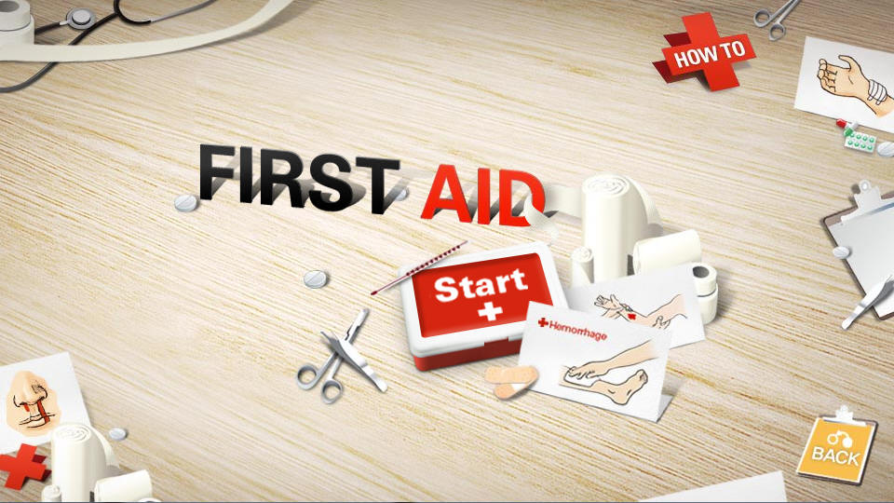
3. Main Page Description
1. Main Menu
Description
1 | Shows information that is needed to use an app
2 | Displaying title
3 | Button to start an app
4 | Move to previous page
5 | Move to previous page
①
②
③
SAMPLE
⑤
④
Detailed Information
(Please write the detailed information for the above image here, if needed.
Note: Description of each button’s function and location required for better understanding (Non-English Apps).

Slide 6
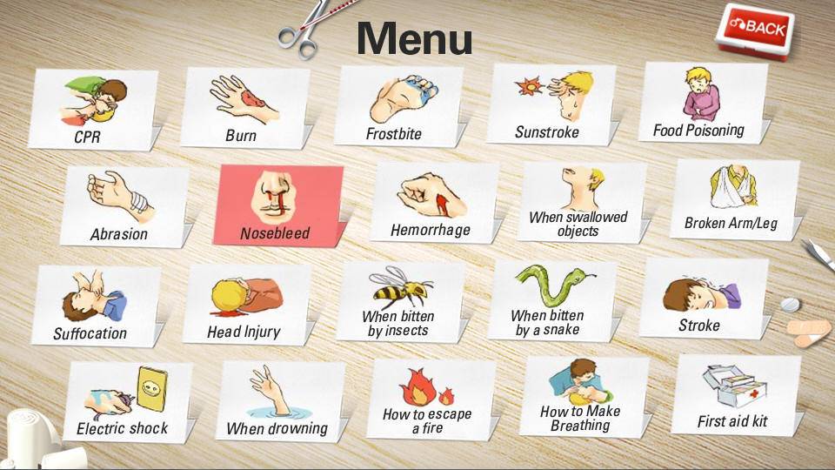
4. Sub Page Description
1. Sub Menu
Description
1 | Move to previous page
2 | Move to each content
①
②
SAMPLE
Detailed Information
- (Please write the detailed information for the above page here, if needed.)

Slide 7
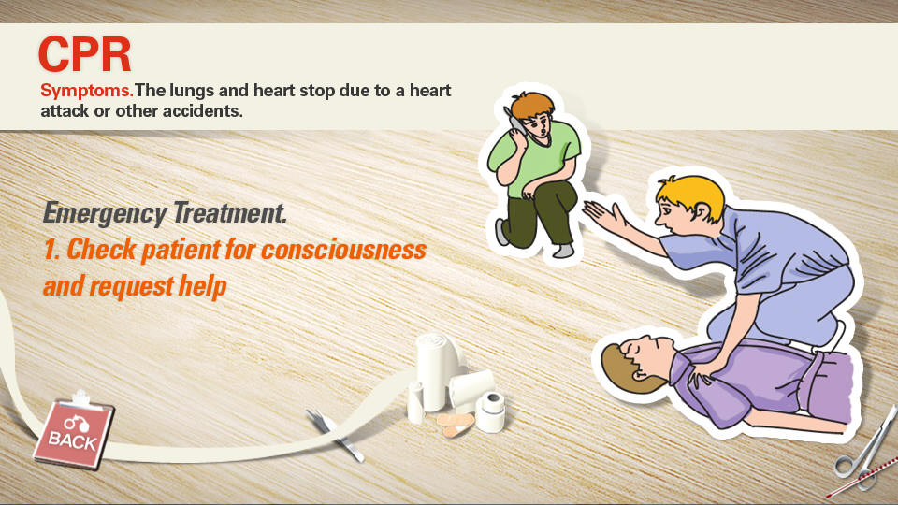
4. Sub Page Description
2. Sub page
Description
1 | Move to previous page
2
②
SAMPLE
①
Detailed Information
- (Please write the detailed information for the above page here, if needed.)

Slide 8

5. AD Information (Required for AD Serving App based on LG AD Platform)
Description
AD Banner Information
1 | Page : Main Page
 | Location : Right upper banner
AD Location Description
2 | AD Type : Display Banner
 | Banner Location X : , Y : , Z :
 | Banner Size 180 * 150
1st AD Page Information (Please describe all AD information)
SAMPLE
Detailed Information
- (Please write the detailed information for the above page here, if needed.)

Slide 9
5. AD Information (Required for AD Serving App based on LG AD Platform)
2nd AD Page Information
Description
AD Banner Information
1 | Page : Main Page > Submenu > CPR Page
 | Location : Right upper banner
AD Location Description
2 | AD Type : Display Banner
 | Banner Location X : , Y : , Z :
 | Banner Size 180 * 150
SAMPLE
Detailed Information
- (Please write the detailed information for the above page here, if needed.)

Slide 10
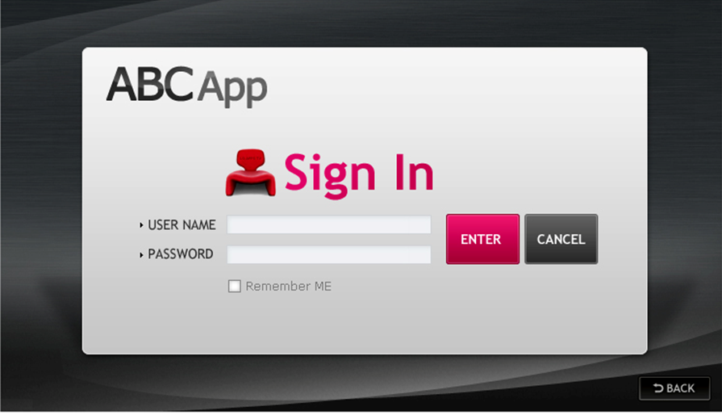
6. Detailed Log-in Information (Required for apps using activation codes or account info)
1. Log-in page
Description
1 | Input field of ID
2 | Input field of password
SAMPLE
①
②
Detailed Information
- Access Activation Codes or Account Information (ID/PWD) needed for App Testing (Three or more are required)
1. ( ) 2. ( ) 3. ( )

Slide 11
[Appendix]
If you have anything left to let LG QA team know, please write here. Any detailed references can be welcomed.
…
..

